Slide 1
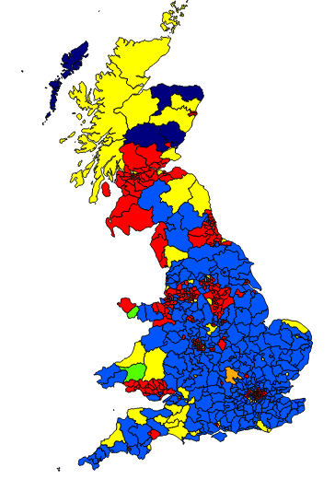

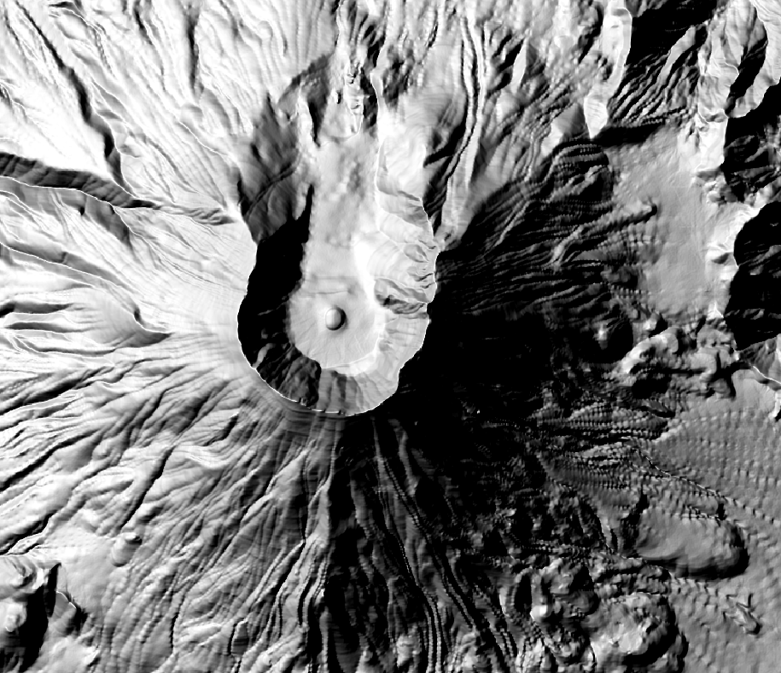
Quantum GIS Practical Training
Azerbaijan Seed Conservation Training (Genetic Resource Institute, Baku)
27th May 2016
A Faruk (lead); C Yesson; R Hope; L Jennings

Slide 2

What is QGIS?

Slide 3
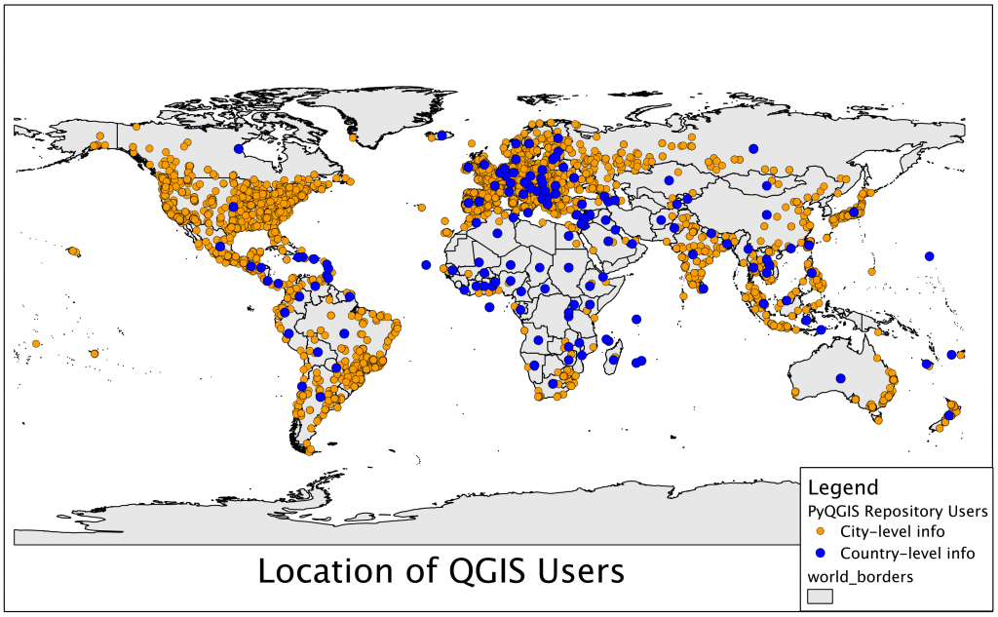
Notes:
Number of QGIS users – census done for 2011 – number of unique PI – estimated around 35,000 but that’s dramatically increased now

Slide 4
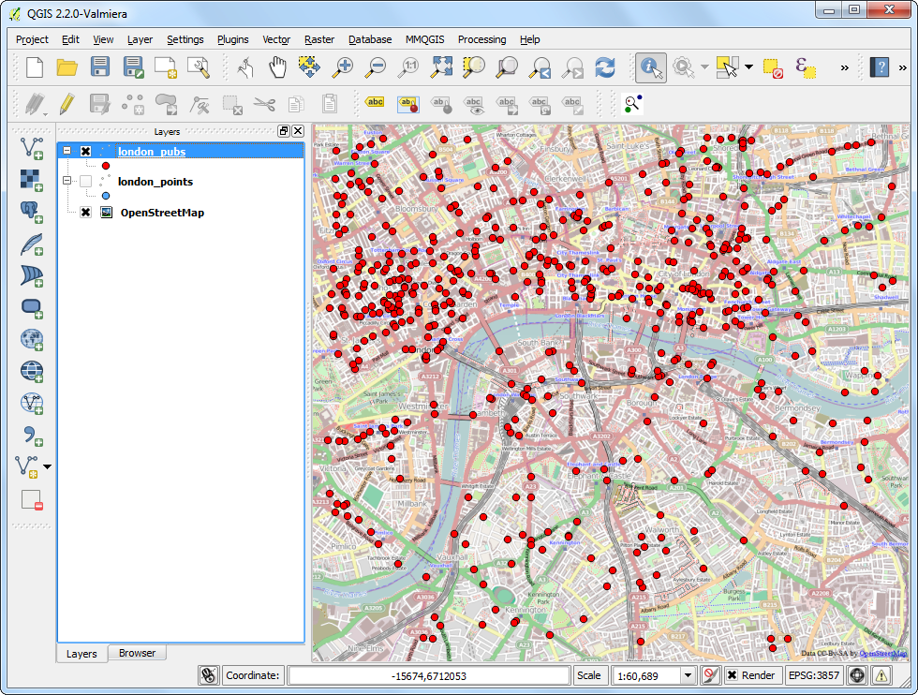
Notes:
Simple points on a map
Downloaded Open Street map overlaid with location of pubs in Greater London

Slide 5
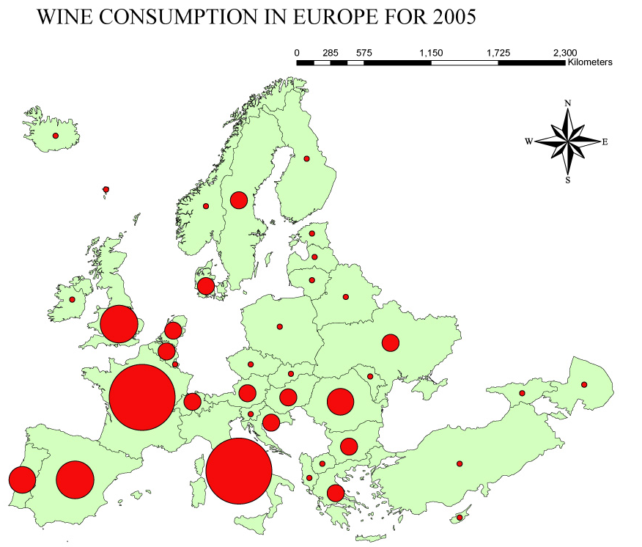
Notes:
In that we can make things a little more interesting – where the circles are proportional to the a particular number – here, we have the amount of wine consumed in Europe

Slide 7
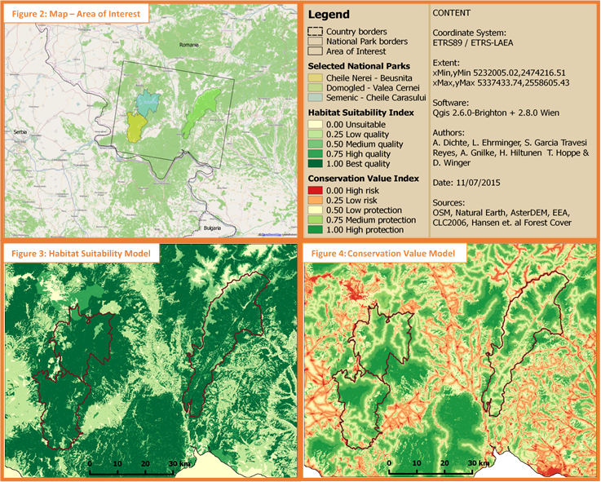
Notes:
To habitat suitability models

Slide 8
QGIS in Project

Slide 9
IT’S FREE!
Support
Getting less buggy…

Slide 10
Useful resources
Along with those in the handout:
Global Forest Watch
(http://www.globalforestwatch.org)
Diva GIS resource tab
(http://www.diva-gis.org/Data)

Slide 11
So, let’s get started!
https://github.com/cyesson/Training?files=1
Or
Google “Github yesson”
ZSL201507

Slide 12
https://xkcd.com/977/
http://spatialreference.org/

Slide 13
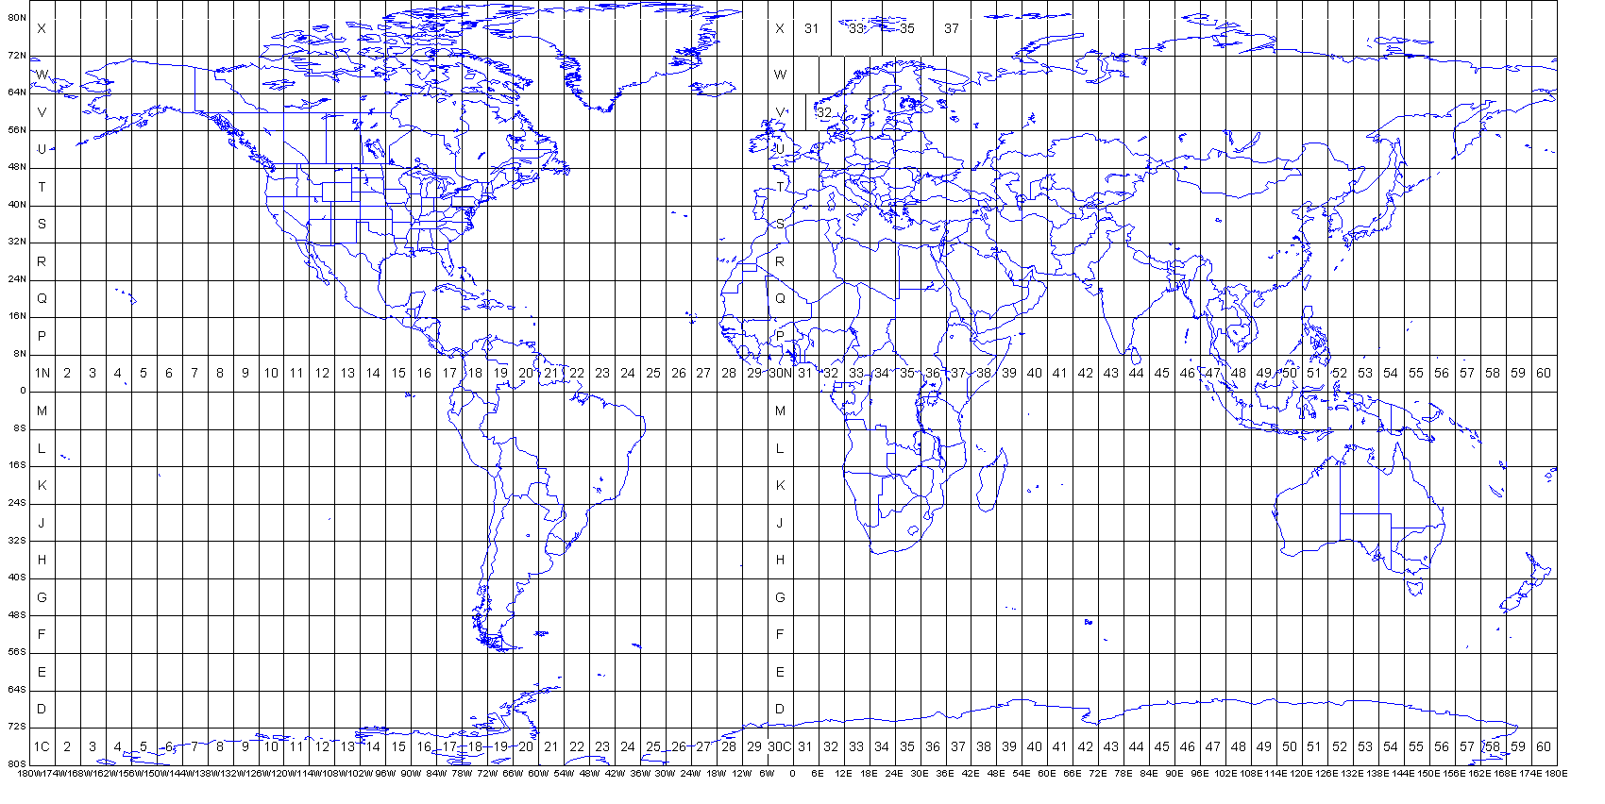

Slide 14
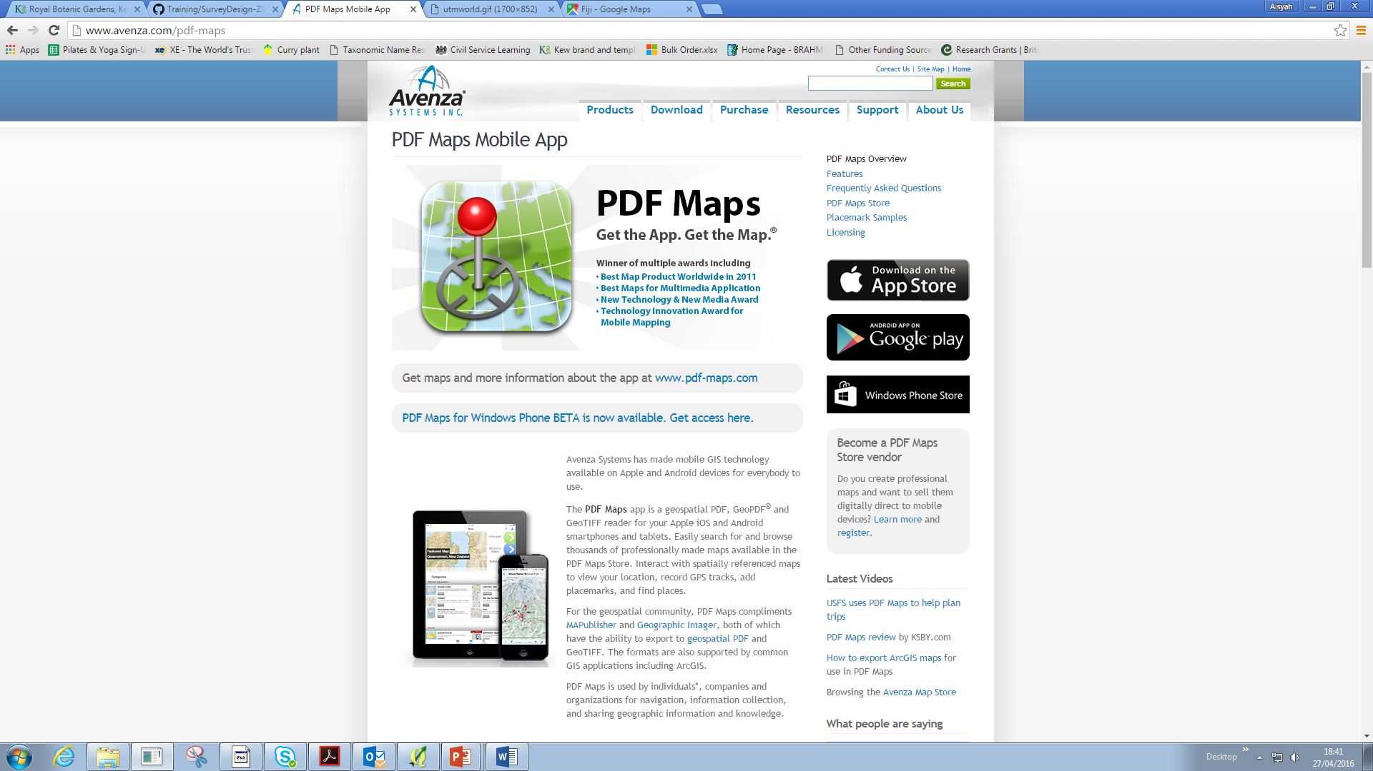
Apps in the field?

Slide 15
Practical 1: Introduction to QGIS
At the end of this session, you will be able to:
Add and edit vector layers (.shp and .kml)
Add and edit raster layers (.tiff)
Look at and query attribute tables
Practical 2: Understanding Coordinate Reference Systems
At the end of this session you will be able to:
Look for and change Coordinate Reference Systems
Produce grids
Measure distances in QGIS
Practical 3: Using QGIS to plan/design field surveys
At the end of this session you will be able to:
Use the OpenLayers Plugin (Google, OSM etc)
Extract GPS data into QGIS
Import Excel data into QGIS
Produce randomised and standardised survey points in a study site
Import survey points from QGIS into GPS
Be familiar with current apps used in the field

Slide 16
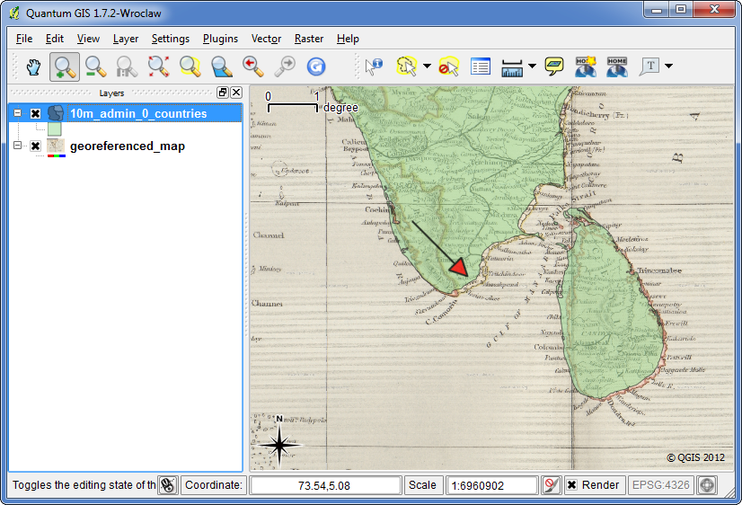
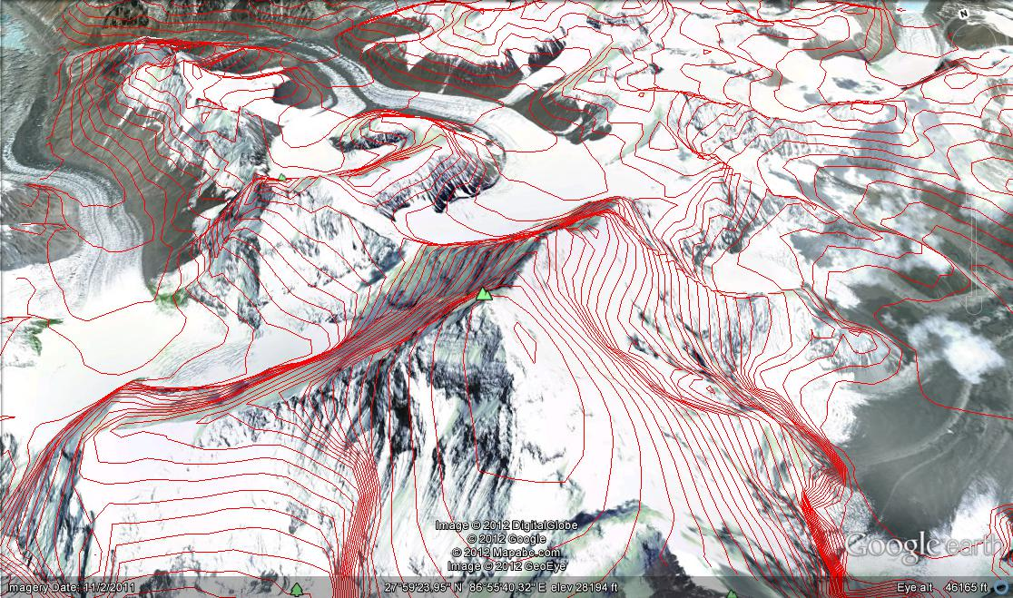
Practical 4: Georectifying pictures and geocoding points
At the end of this session you will be able to:
Digitally align a picture or aerial images to a map
Transform addresses and places into coordinates
Practical 5: Producing professional looking figures with print composer
At the end of this session you will be able to:
Add and edit legend, scale bar and compass
Add and edit atlas view in the final figure
Add and edit grid lines in the final figure
Export a map into PDF, JPEG or TIFF
Practical 6: Producing Digital Elevation Models with QGIS
At the end of this session you will be able to:
Produce contours and hill shade layers
Produce and edit new polygons
Use point sampling tool to extract environmental values

